Slide 1
Objectives
In this session, you will learn to:
Identify the SQL Server tools
Retrieve Data

Slide 2
Identifying SQL Server Tools
Before you start working on SQL Server, it is important to identify the various tools and their features provided by SQL Server.
Notes:
2
Student already have learnt about type 2 SCDs in Module I. Therefore, you can start this topic by asking the following questions to students:
What are type 2 SCDs?
Given an example to explain type 2 SCDs.
This will recapitulate what they have learnt about type 2 SCD in Module 1.
Now explain the strategy to update the data into these dimension tables with help the example given in SG.
After explaining the examples, you can ask students to think of an example of a type 2 SCD and then tell the strategy to update the data into this dimension table.

Slide 3
SQL Server Management Studio
Is a powerful tool associated with SQL Server.
Provides a simple and integrated environment for developing and managing the SQL Server database objects.
Notes:
Student already have learnt about type 2 SCDs in Module I. Therefore, you can start this topic by asking the following questions to students:
What are type 2 SCDs?
Given an example to explain type 2 SCDs.
This will recapitulate what they have learnt about type 2 SCD in Module 1.
Now explain the strategy to update the data into these dimension tables with help the example given in SG.
After explaining the examples, you can ask students to think of an example of a type 2 SCD and then tell the strategy to update the data into this dimension table.

Slide 4
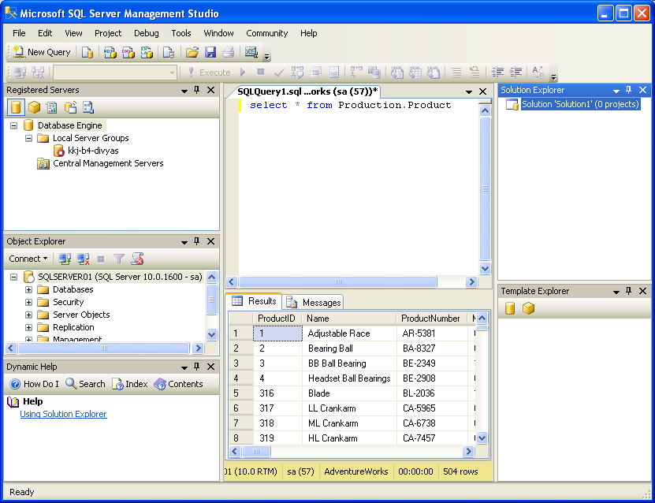
SQL Server Management Studio (Contd.)
The following figure shows the SQL Server Management Studio interface.
Solution Explorer
Registered Servers
Query Editor
Object Explorer
Template Explorer
Dynamic Help
Let us see how to open SQL Server Management Studio.
Notes:
Student already have learnt about type 2 SCDs in Module I. Therefore, you can start this topic by asking the following questions to students:
What are type 2 SCDs?
Given an example to explain type 2 SCDs.
This will recapitulate what they have learnt about type 2 SCD in Module 1.
Now explain the strategy to update the data into these dimension tables with help the example given in SG.
After explaining the examples, you can ask students to think of an example of a type 2 SCD and then tell the strategy to update the data into this dimension table.

Slide 5
SQL Server Business Intelligence Development Studio
Is a tool that provides an environment to develop business intelligence solutions.
Contains templates, tools, and wizards to work with objects that you can use to create business intelligence solutions.
Helps build the following types of solutions:
Data integration
Data analysis
Data reporting
Notes:
Student already have learnt about type 2 SCDs in Module I. Therefore, you can start this topic by asking the following questions to students:
What are type 2 SCDs?
Given an example to explain type 2 SCDs.
This will recapitulate what they have learnt about type 2 SCD in Module 1.
Now explain the strategy to update the data into these dimension tables with help the example given in SG.
After explaining the examples, you can ask students to think of an example of a type 2 SCD and then tell the strategy to update the data into this dimension table.

Slide 6
Database Engine Tuning Advisor
Helps database administrators to analyze and tune the performance of the server.
Provides recommendations to add, remove, or modify database objects, such as indexes or indexed views to improve performance.
Notes:
Student already have learnt about type 2 SCDs in Module I. Therefore, you can start this topic by asking the following questions to students:
What are type 2 SCDs?
Given an example to explain type 2 SCDs.
This will recapitulate what they have learnt about type 2 SCD in Module 1.
Now explain the strategy to update the data into these dimension tables with help the example given in SG.
After explaining the examples, you can ask students to think of an example of a type 2 SCD and then tell the strategy to update the data into this dimension table.

Slide 7
SQL Server Configuration Manager
Helps the database administrators to manage the services associated with SQL Server.
Allows you to manage the network connectivity configuration from the SQL Server client computers.
Allows you to specify the protocols through which the client computers can connect to the server.
Notes:
Student already have learnt about type 2 SCDs in Module I. Therefore, you can start this topic by asking the following questions to students:
What are type 2 SCDs?
Given an example to explain type 2 SCDs.
This will recapitulate what they have learnt about type 2 SCD in Module 1.
Now explain the strategy to update the data into these dimension tables with help the example given in SG.
After explaining the examples, you can ask students to think of an example of a type 2 SCD and then tell the strategy to update the data into this dimension table.

Slide 8
SQL Server Profiler
Helps in monitoring the events, such as login connections, execution of DML statements, stored procedures, batches, and security permission checks that are generated within an instance of a database engine.
Provides an in depth view of the query submission, access of the database against the queries, and return of results after processing of queries.

Slide 9
Just a minute
Which of the following windows of SQL Server Management Studio is used to automate administrative tasks by creating and managing jobs, alerts, and operators?
Object Explorer
Solution Explorer
Registered Servers
Template Explorer
Solution:
1. Object Explorer

Slide 10
Retrieving Data
To retrieve data, you first need to understand the various data types used in SQL Server.
Notes:
10
Student already have learnt about type 2 SCDs in Module I. Therefore, you can start this topic by asking the following questions to students:
What are type 2 SCDs?
Given an example to explain type 2 SCDs.
This will recapitulate what they have learnt about type 2 SCD in Module 1.
Now explain the strategy to update the data into these dimension tables with help the example given in SG.
After explaining the examples, you can ask students to think of an example of a type 2 SCD and then tell the strategy to update the data into this dimension table.

Slide 11
Identifying Data Types
Data types:
Specify the type of data that an object can contain.
Can be associated with each column, local variable, or an expression defined in the database.
You can store the following types of data in a database:
Structured data
Semi-structured data
Unstructured data
Notes:
You can summarize the session by running through the summary given in SG.
In addition, you can also ask students summarize what they have learnt in this session.

Slide 12
Identifying Data Types (Contd.)
The following table lists some of the data types supported by SQL Server.
Data type | Range | Used to store | Storage (Bytes)
int | –2^31 (–2,147,483,648) to 2^31–1 (2,147,483,647) | Integer data (whole numbers) | 4
float | –1.79E+308 to –2.23E–308, 0 and 2.23E–308 to 1.79E+308 | Floating precision data | 4 to 8
money | –922,337,203,685,477.5808 to 922,337,203,685,477.5807 | Monetary data | 8
char(n) | n characters, where n can be 1 to 8000 | Fixed length character data | n
varchar(n) | n characters, where n can be 1 to 8000 | Variable length character data | n+2
xml | xml instances and xml type variables | Store and return xml values | Variable size
Geometry | Two-dimensional data | Geometrical shapes, such as points, lines, and polygon | Variable size
geography | Ellipsoidal data | Geographical data, such as the latitude and longitude coordinates that represent points, lines, and polygons on the earth’s surface | Variable size
Notes:
You can summarize the session by running through the summary given in SG.
In addition, you can also ask students summarize what they have learnt in this session.

Slide 13
Summary
In this session, you learned that:
SQL Server provides the following tools to improve the efficiency of the database developers and manage the server:
SQL Server Management Studio
SQL Server Business Intelligence Development Studio
Database Engine Tuning Advisor
SQL Server Configuration Manager
SQL Server Profiler
Data type represents the type of data that a database object can contain.
You can store the following types of data in a database:
Structured data
Semi-structured data
Unstructured data
Notes:
You can summarize the session by running through the summary given in SG.
In addition, you can also ask students summarize what they have learnt in this session.

